Slide 1
12/11

Slide 2
ViT small demo
With freezing layer:
Training accuracy: 68.7%, Loss: 0.075
Testing accuracy: 67.0056%, Loss: 0.60904349
Without freezing layer:
Training accuracy: 88.5 %, Loss: 0.029
Testing accuracy: 77.8531%, Loss: 0.72010663

Slide 3
4/8

Slide 4
Result
Min max normalization was applied.
Removed all the uncompleted data (missing T1 or Flare)

Slide 5
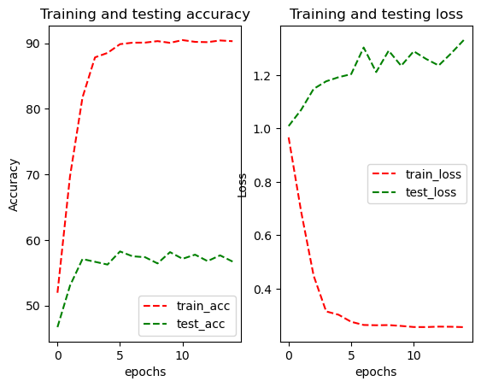
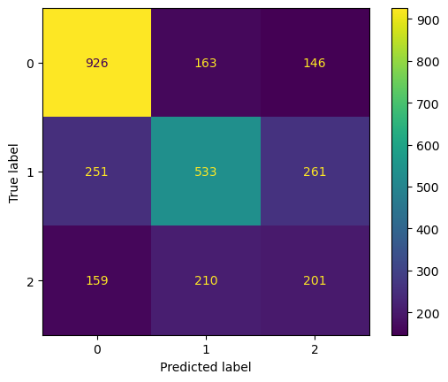
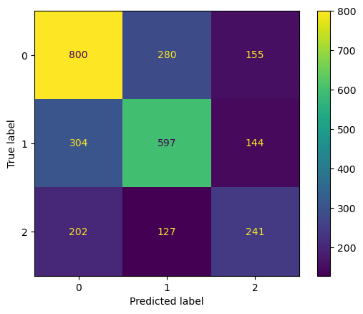
EfficientNet Result
Validat Matrix
EPOCHS = 15
LEARNING_RATE = 0.0003
BATCH_SIZE = 48
Highest Accuracy:
Training Accuracy: 89.8585%, Training Loss: 0.27595837
Validation Accuracy: 58.2456%, Validation Loss: 1.20349601
Testing Accuracy: 57.4737%, Testing Loss: 1.17209294
Test Matrix

Slide 6
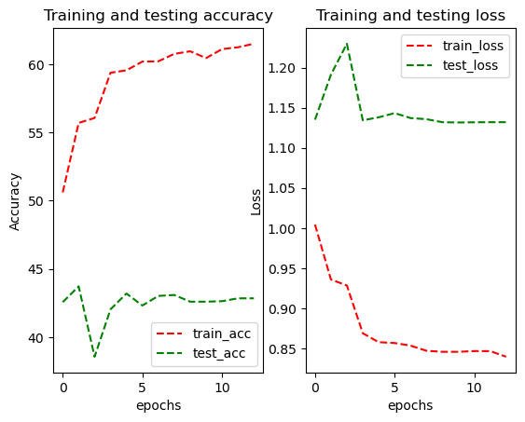
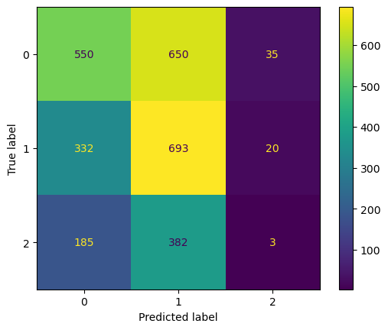
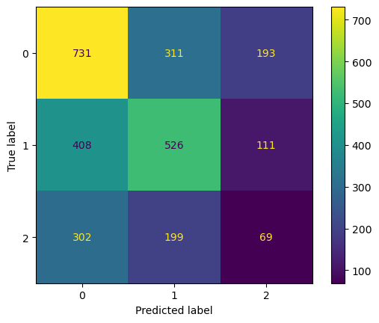
ViT Result
Validat Matrix
EPOCHS = 10
LEARNING_RATE = 0.0004
BATCH_SIZE = 48
Highest Accuracy:
Training Accuracy: 55.6989%, Training Loss: 0.93576634
Validation Accuracy: 43.7193%, Validation Loss: 1.19144470
Testing Accuracy: 45.7544%, Testing Loss: 1.08333243
Test Matrix

Slide 7
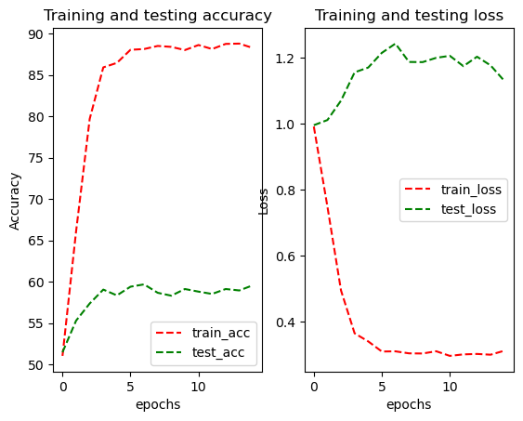
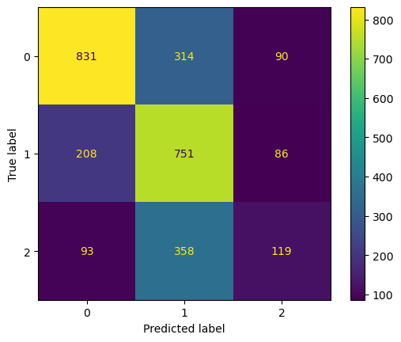
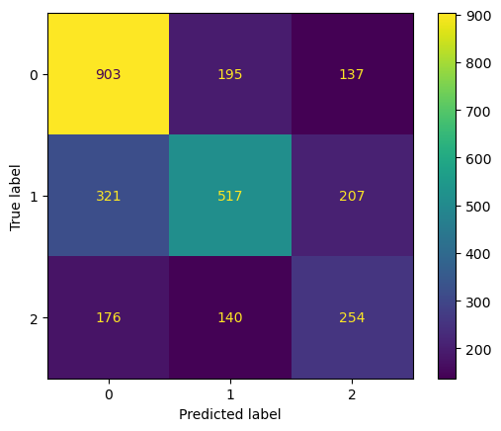
EfficientNet Result
Validate Matrix
EPOCHS = 15
LEARNING_RATE = 0.0003
BATCH_SIZE = 48
Highest Accuracy:
Training Accuracy: 88.1494%, Training Loss: 0.31102509
Validation Accuracy: 59.6842%, Validation Loss: 1.24253614
Testing Accuracy: 58.7368%, Testing Loss: 1.14878252
Test Matrix

Slide 8
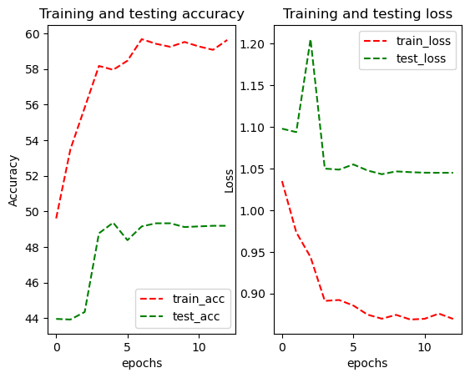
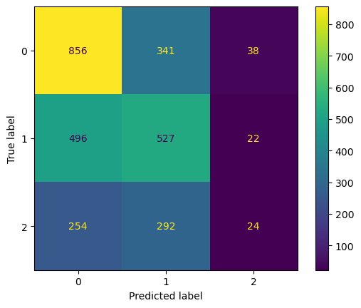
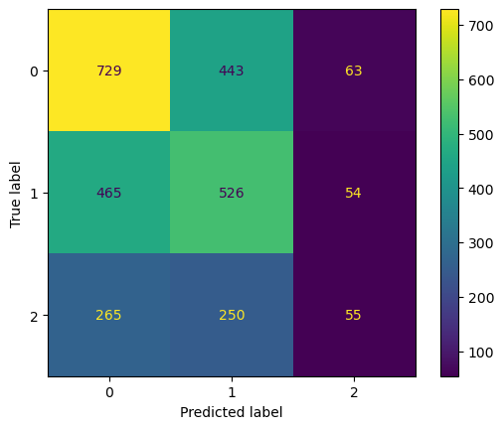
ViT Result
Validat Matrix
EPOCHS = 10
LEARNING_RATE = 0.0004
BATCH_SIZE = 48
Highest Accuracy:
Training Accuracy: 57.9513%, Training Loss: 0.89222579
Validation Accuracy: 49.3684%, Validation Loss: 1.04861604
Testing Accuracy: 45.9649%, Testing Loss: 1.08246572
Test Matrix

Slide 9
4/23

Slide 10
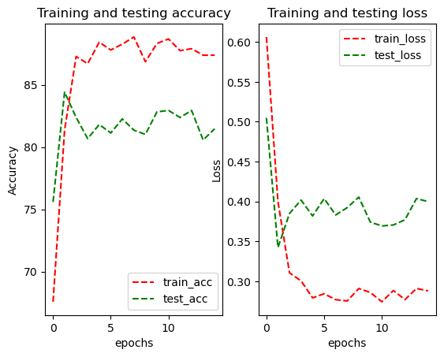
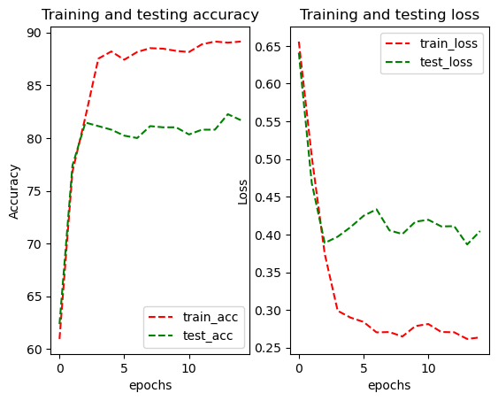
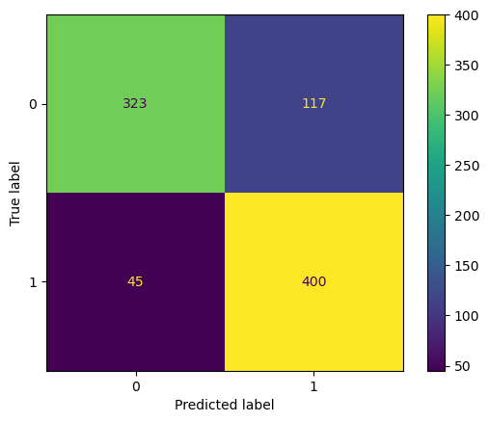
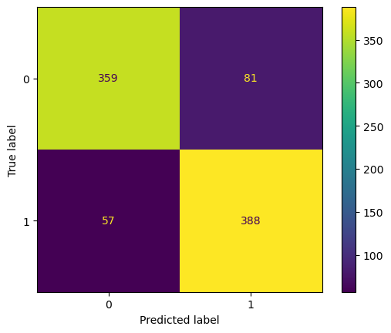
Testing code error with old dataset (SPMS vs RRMS)
Efficient Net(form old code)
Testing Accuracy: 84.4068%, Testing Loss: 0.34227082
Efficient Net(form new code)
Testing Accuracy: 81.6949%, Testing Loss: 0.40459349
Notes:
Training code does not show any error
The new result is same the old trail

Slide 11
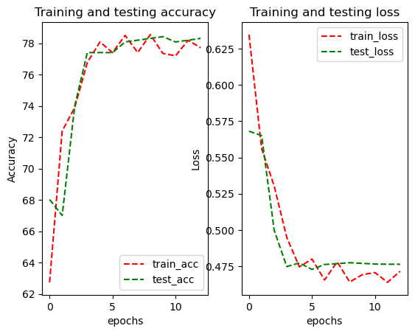
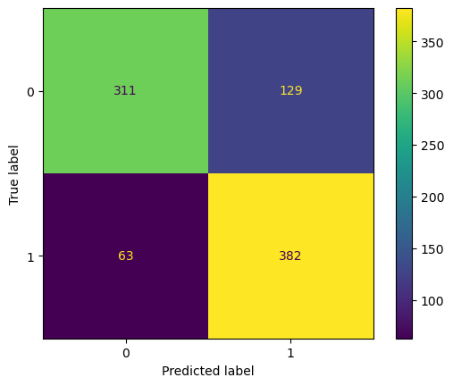
Re test old dataset(SPMS vs RRMS 10 : 9) by ViT and EffNet
Efficient Net(form new code)
Testing Accuracy: 81.6949%, Testing Loss: 0.40459349
ViT
Testing Accuracy: 78.3051%, Testing Loss: 0.47626233
Notes:
All the preprocess steps are the same, only changed the model, with the new code.
ViT model: vit_l_16(weights='ViT_L_16_Weights.IMAGENET1K_V1')

Slide 12
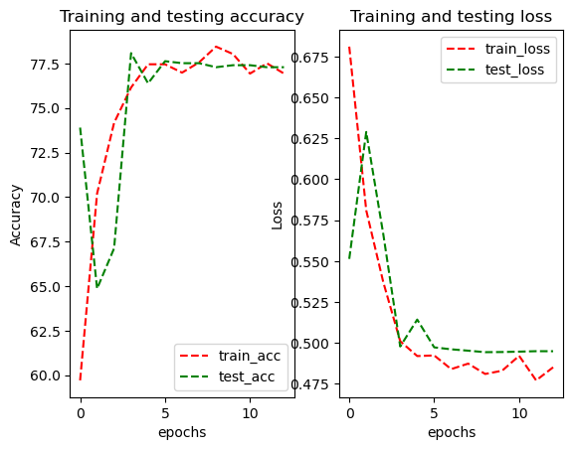
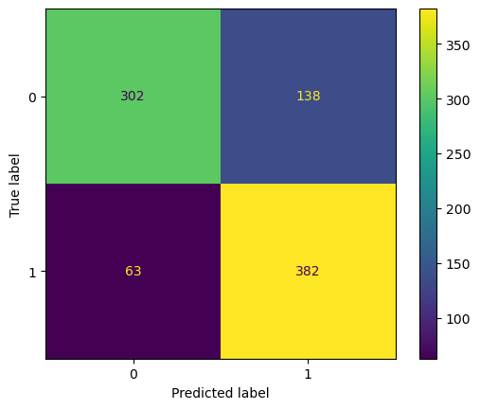
vit_l_16 vs vit_b_32
ViT
Testing Accuracy: 78.3051%, Testing Loss: 0.47626233
ViT
Testing Accuracy: 77.2881%, Testing Loss: 0.49488477
Notes:
No signicant difference between

Slide 13
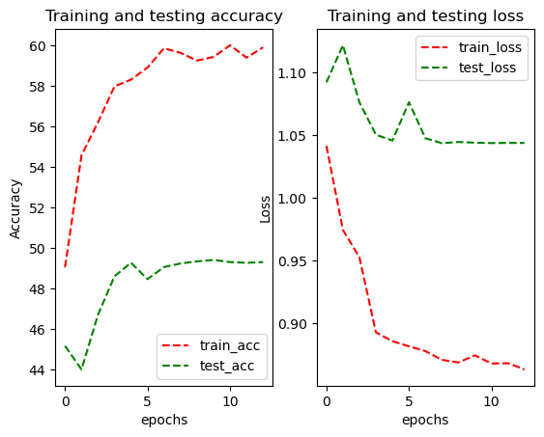
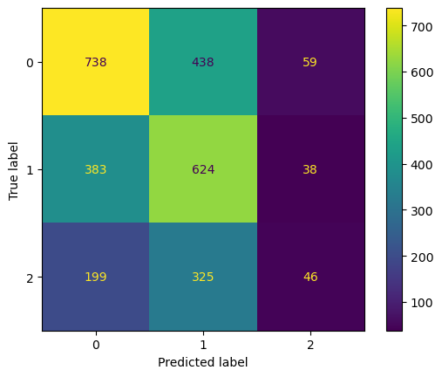
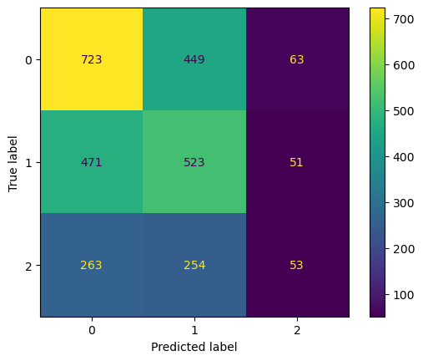
Test for new dataset (Trail 1)
ViT
Training Accuracy: 59.4227%, Training Loss: 0.87475052
Validation Accuracy: 49.4035%, Validation Loss: 1.04412205
Testing Accuracy: 45.5789%, Testing Loss: 1.08705957
Val: Test:

Slide 14
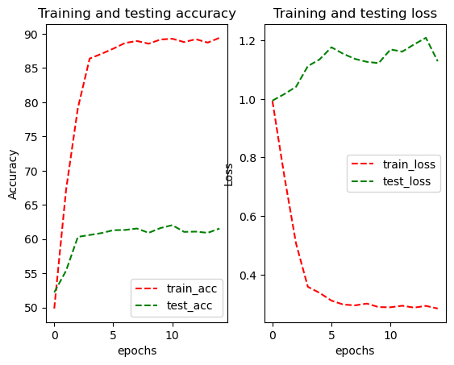
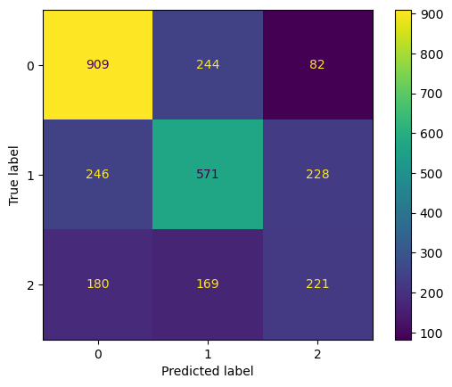
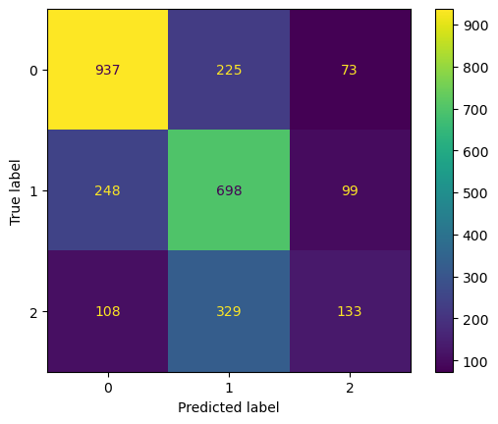
Test for new dataset (Trail 1)
Efficient Net
Training Accuracy: 89.2813%, Training Loss: 0.28849230
Validation Accuracy: 62.0351%, Validation Loss: 1.16898684
Testing Accuracy: 59.6842%, Testing Loss: 1.14959931
Val: Test:

Slide 15
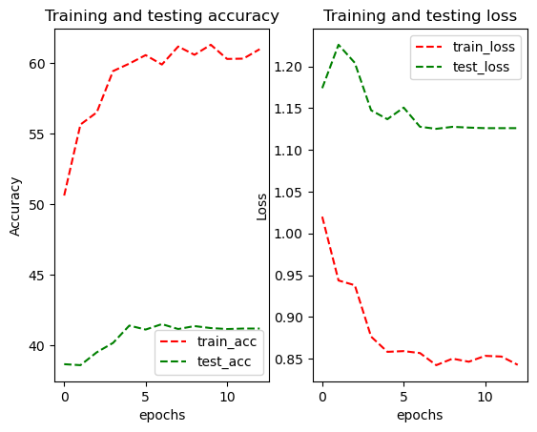
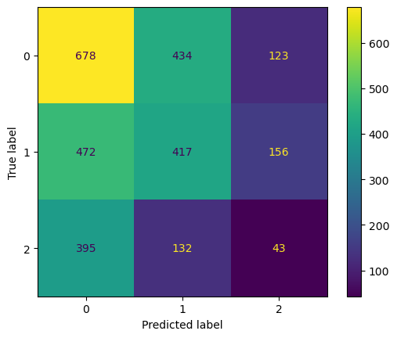
Test for new dataset (Trail 2)
ViT
Training Accuracy: 61.0074%, Training Loss: 0.84265842
Validation Accuracy: 41.1930%, Validation Loss: 1.12600279
Testing Accuracy: 39.9298%, Testing Loss: 1.17207851
Val: Test:

Slide 16
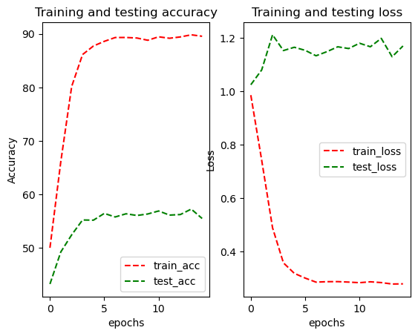
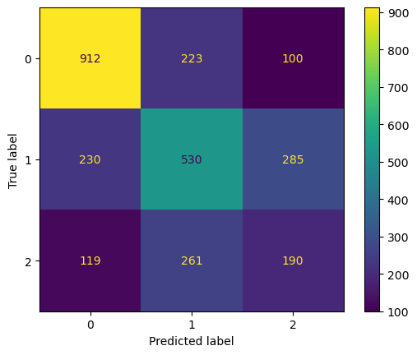
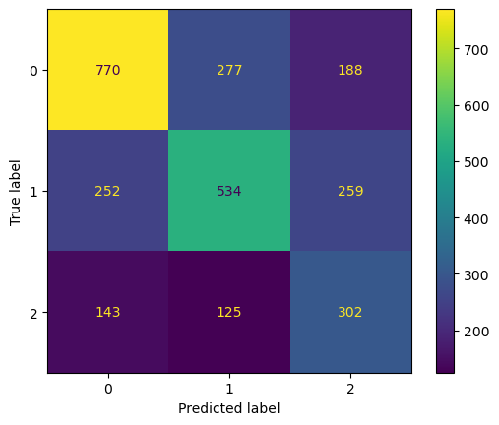
Test for new dataset (Trail 2)
Efficient Net
Training Accuracy: 89.8246%, Training Loss: 0.27791537
Validation Accuracy: 57.2632%, Validation Loss: 1.12869881
Testing Accuracy: 56.3509%, Testing Loss: 1.36861132
Val: Test:

Slide 17
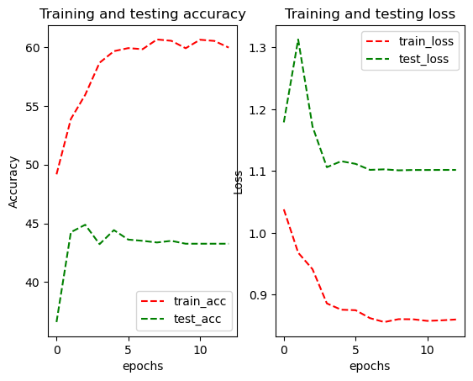
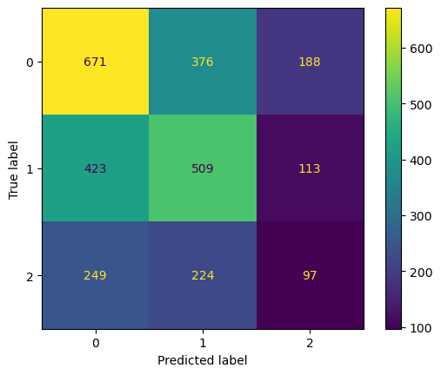
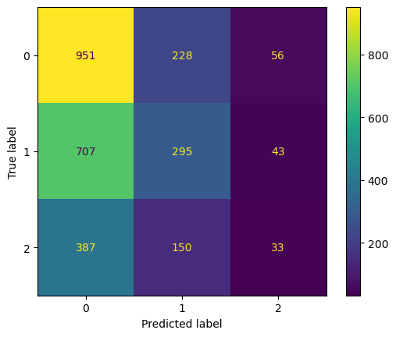
Test for new dataset (Trail 3)
ViT
Training Accuracy: 55.9366%, Training Loss: 0.94131951
Validation Accuracy: 44.8772%, Validation Loss: 1.17221839
Testing Accuracy: 44.8070%, Testing Loss: 1.09684327
Val: Test:

Slide 18
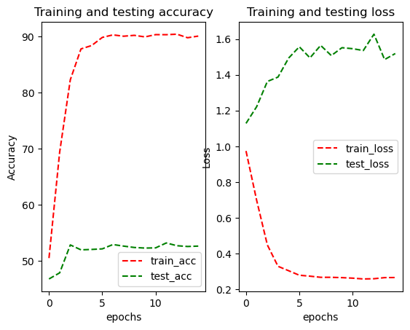
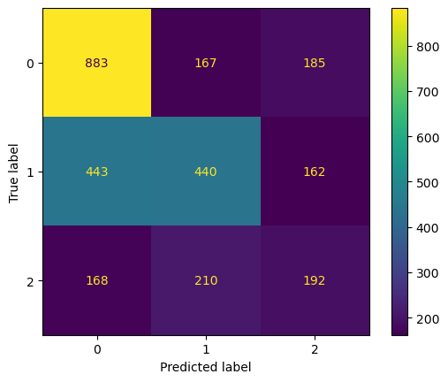
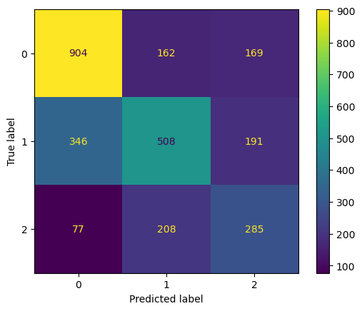
Test for new dataset (Trail 3)
Efficient Net
Training Accuracy: 90.3113%, Training Loss: 0.25852127
Validation Accuracy: 53.1579%, Validation Loss: 1.53561992
Testing Accuracy: 59.5439%, Testing Loss: 1.24602813
Val: Test:

Slide 19
Baseline for 1,2,3,4 year.
+- data augmentation and upsampling for the new dataset.

Slide 20
6/5

Slide 21
Efficient Net

Slide 22
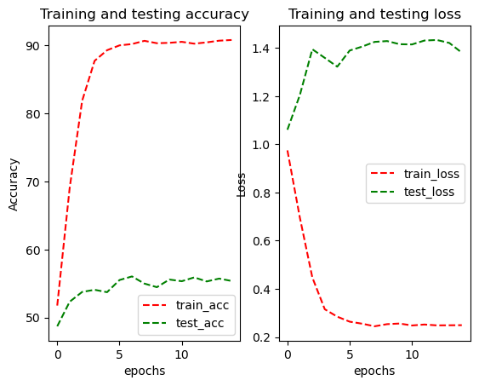
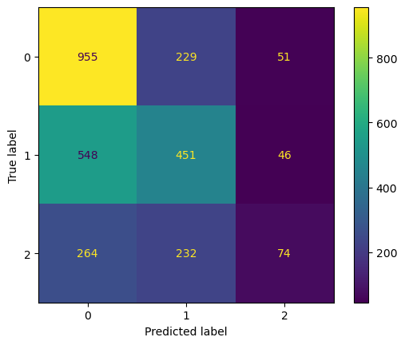
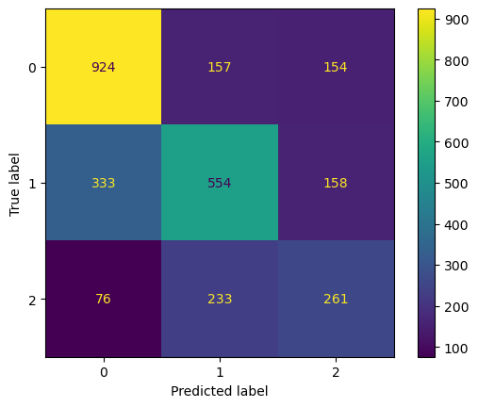
Base
Efficient Net
Training Accuracy: 90.2207%, Training Loss: 0.25533032
Validation Accuracy: 56.0351%, Validation Loss: 1.40603082
Testing Accuracy: 61.0175%, Testing Loss: 1.16426103
Val: Test:
Notes:
+2.0 %

Slide 23
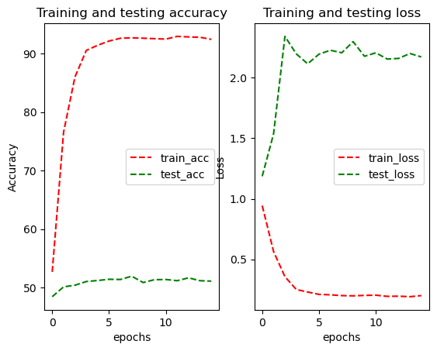
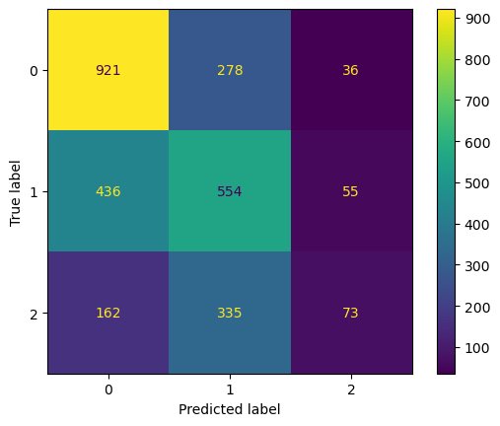
Upsampling method
SMOTE
Efficient Net
Training Accuracy: 92.7126%, Training Loss: 0.20011175
Validation Accuracy: 51.9298%, Validation Loss: 2.20665071
Testing Accuracy: 54.3158%, Testing Loss: 1.89822476
Val: Test:

Slide 24
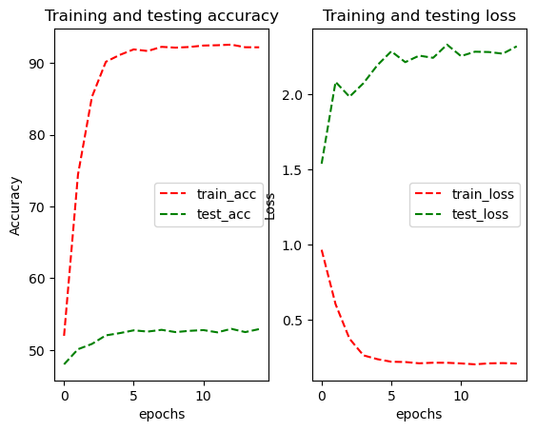
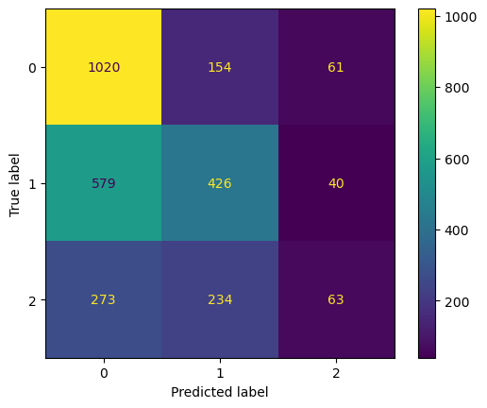
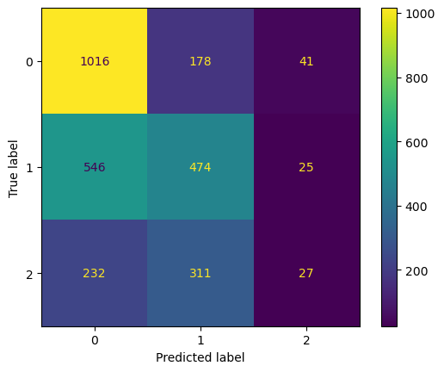
Upsampling method
SMOTE + ENN
Efficient Net
Training Accuracy: 92.5507%, Training Loss: 0.20858642
Validation Accuracy: 52.9474%, Validation Loss: 2.28358639
Testing Accuracy: 53.2281%, Testing Loss: 2.09202766
Val: Test:

Slide 25
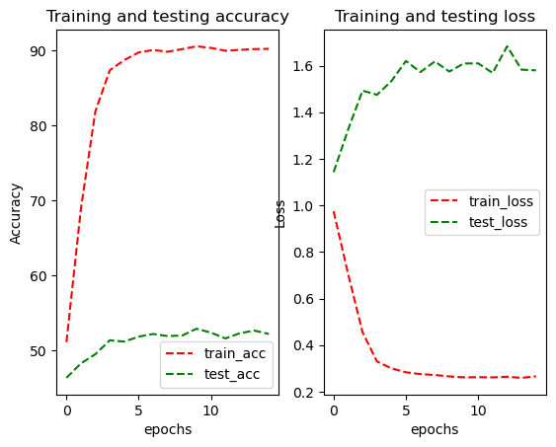
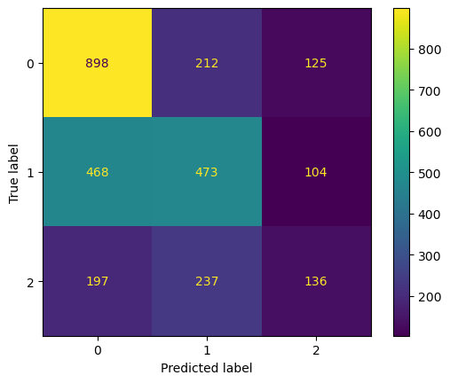
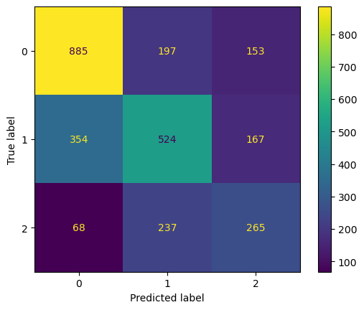
DA method
RandomApply( flip, rotate, brightness, contrast)
Efficient Net
Training Accuracy: 90.5942%, Training Loss: 0.26177135
Validation Accuracy: 52.8772%, Validation Loss: 1.60948780
Testing Accuracy: 58.7368%, Testing Loss: 1.21559799
Val: Test:

Slide 26
ViT

Slide 27
Upsampling method
Base
ViT
Training Accuracy: 55.9366%, Training Loss: 0.94131951
Validation Accuracy: 44.8772%, Validation Loss: 1.17221839
Testing Accuracy: 44.8070%, Testing Loss: 1.09684327
Val: Test:

Slide 28
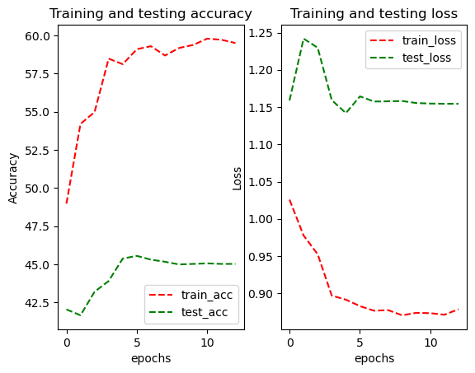
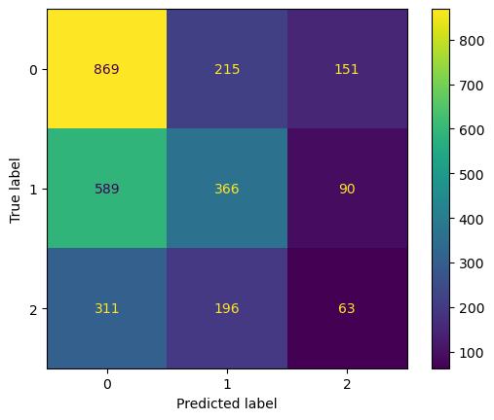

Upsampling method
SMOTE
ViT
Training Accuracy: 59.0913%, Training Loss: 0.88284417
Validation Accuracy: 45.5439%, Validation Loss: 1.16432022
Testing Accuracy: 40.2807%, Testing Loss: 1.23513258
Val: Test:

Slide 29



Upsampling method
SMOTE + ENN
ViT
Training Accuracy: 59.5583%, Training Loss: 0.88049123
Validation Accuracy: 45.1579%, Validation Loss: 1.14443192
Testing Accuracy: 40.9825%, Testing Loss: 1.23706600
Val: Test:

Slide 30



DA method
RandomApply( flip, rotate, brightness, contrast)
ViT
Training Accuracy: 48.6248%, Training Loss: 1.02788169
Validation Accuracy: 46.7018%, Validation Loss: 1.09256272
Testing Accuracy: 44.8772%, Testing Loss: 1.09868620
Val: Test:

Slide 31
Summary
Efficient Net | Base (%) | Smote (%) | Smote + ENN (%) | Data Augmentation | DA + upsampling
Val acc | 56 ± 1 | 52 ± 2 | 53 ± 3 | 54 ± 3 | 49 ± 4
Test acc | 61 ± 2 | 54 ± 1 | 53 ± 2 | 50 ± 4 | 51 ± 3
ViT | Base (%) | Smote (%) | Smote + ENN (%) | Data Augmentation | DA + upsampling
Val acc | 44 ± 3 | 46 ± 1 | 45 ± 3 | 46 ± 2 | 46 ± 3
Test acc | 44 ± 2 | 40 ± 3 | 40 ± 4 | 45 ± 3 | 40 ± 4
Notes:
Upsampling 39: 39:39

Slide 32
Swin transformer
Accuracy: all most same as the ViT (±3%)
Computing time: decrease 40% training time
Notes:
On Image 1k, 21k, swin improves 3% on testing accuracy
Hugging face: 2~4% depends on dataset

Slide 33
Classification recent model
Mamba
SS-Conv-SSM Block
KAN

